Slide 1
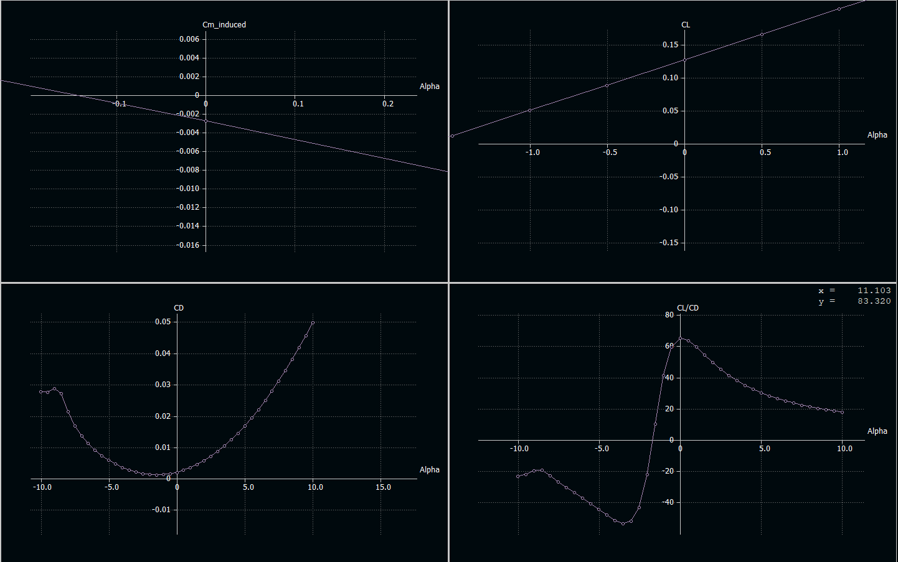
XFLR5 Sims!

Slide 2
Getting Set Up

Slide 3

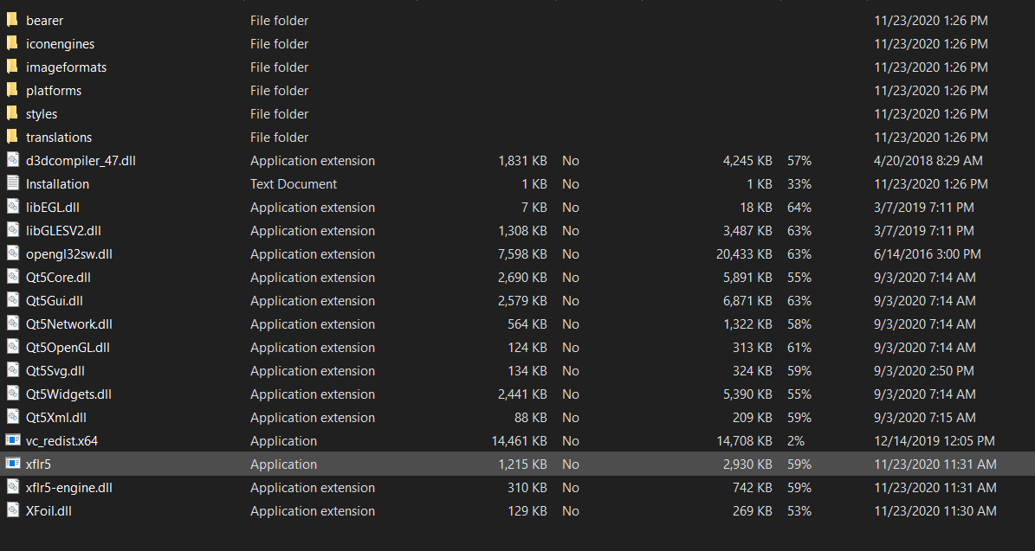
Getting the program
Go to this site
Yes it’s sketchy. Don’t worry.

Slide 4

You should be here
Note: you’ll have to turn off any anti-virus and the security on a mac

Slide 5
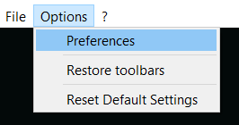
Units pt 1

Slide 6
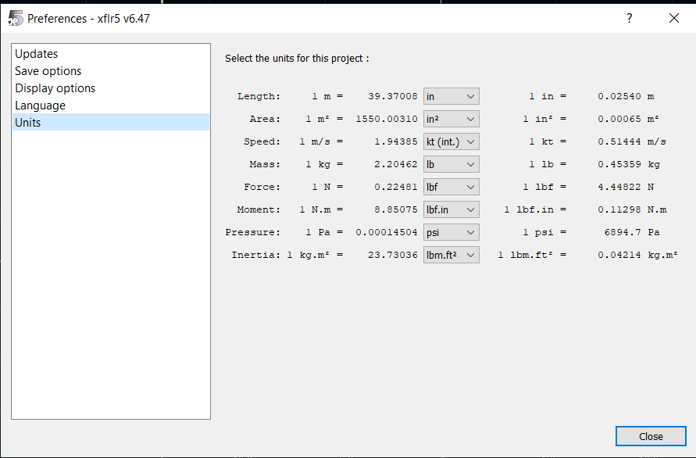
Units pt 2

Slide 7

Download 2 things:
Clark Y .dat file
Flat plane .dat file
Note: make sure the file on your computer ends in “.dat” !!
XFLR5 only recognizes .dat files with “.dat” in the name bc it’s quirky like that

Slide 8
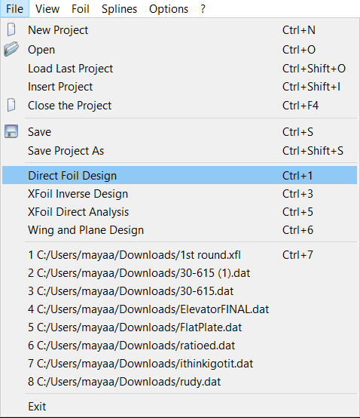
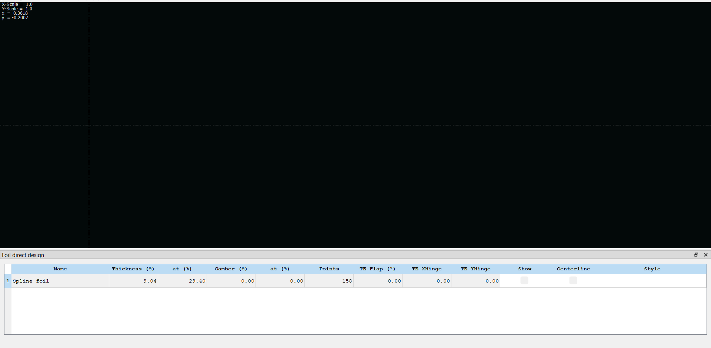
Input the foils you need
File > Direct Foil Design

Slide 9
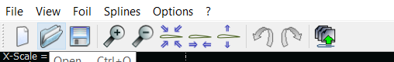
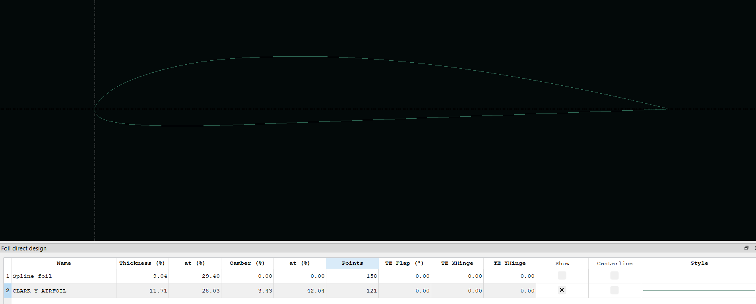
Input foil pt. 2
Then you’ll open the .dat file and get this screen

Slide 10
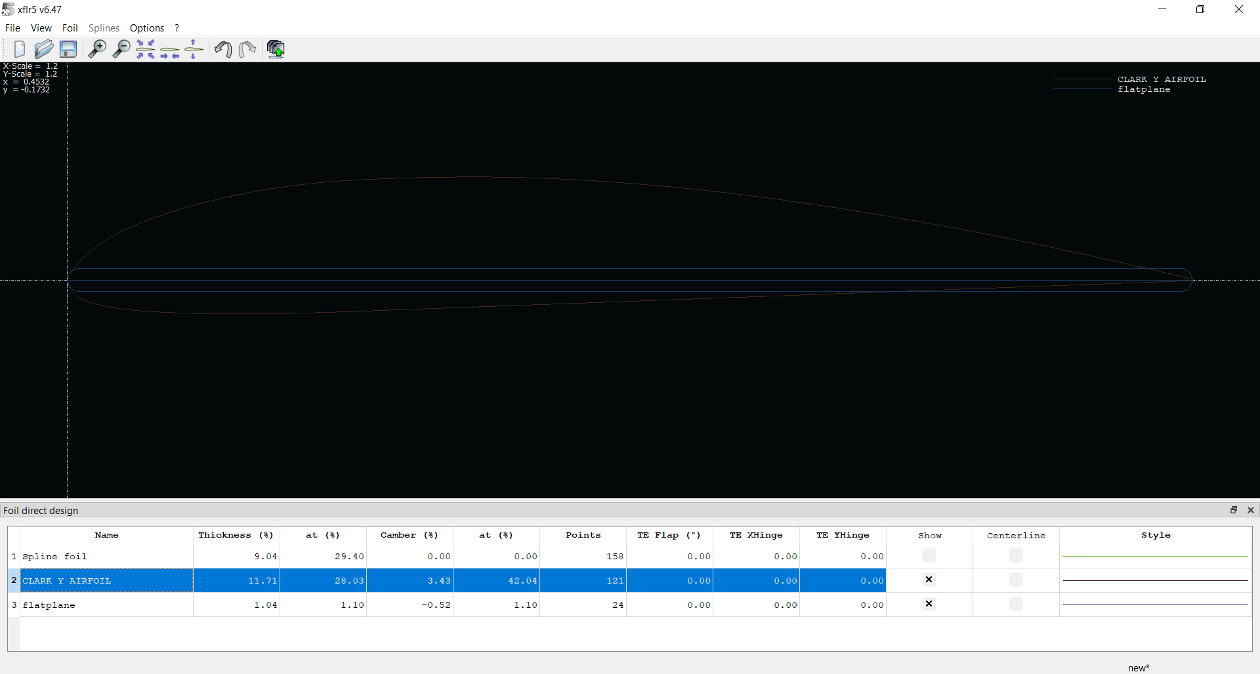
Now do the same for the flatplate
xflr5 is in permanent dark mode so sorry the pics are not showing up amazing
Pro tip: you can right click the foil to rename it

Slide 11

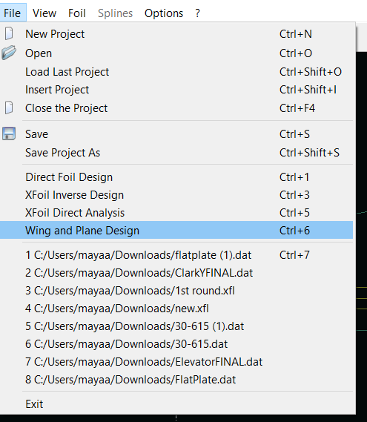

Starting your plane
First off, press save
Then:
For a windows, it’ll be at the top.
For mac, you’ll have to right click first to get this (I think?)

Slide 12
Dimensions

Slide 13
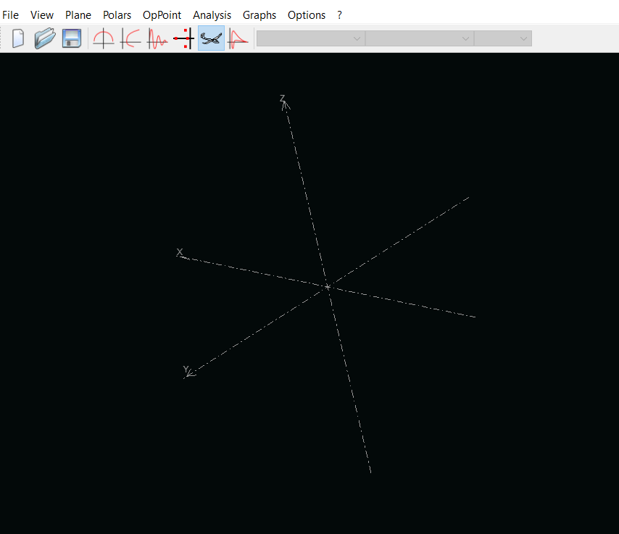
You should be here:
This is where you’re gonna create your plane.
You’ll be designing and adding mass to: rudder, elevator, wing
Everything else is going to be represented through a point mass

Slide 14
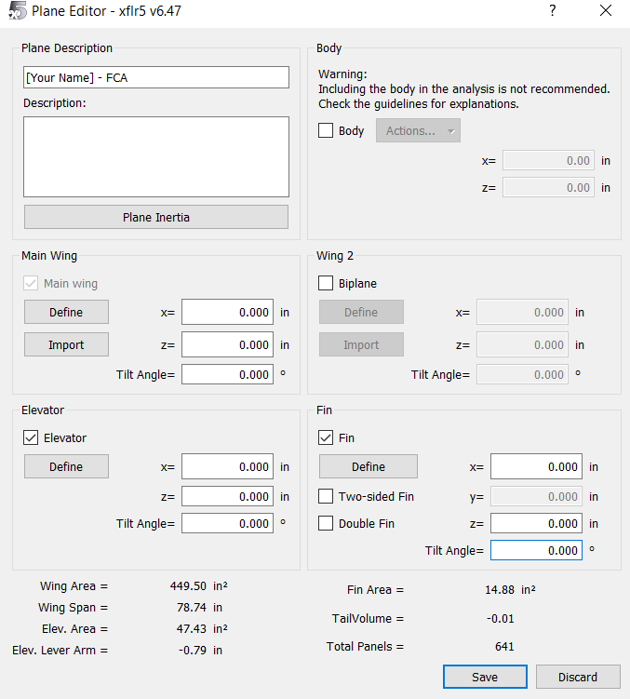
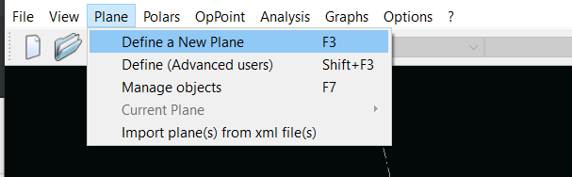
Creating your plane

Slide 15
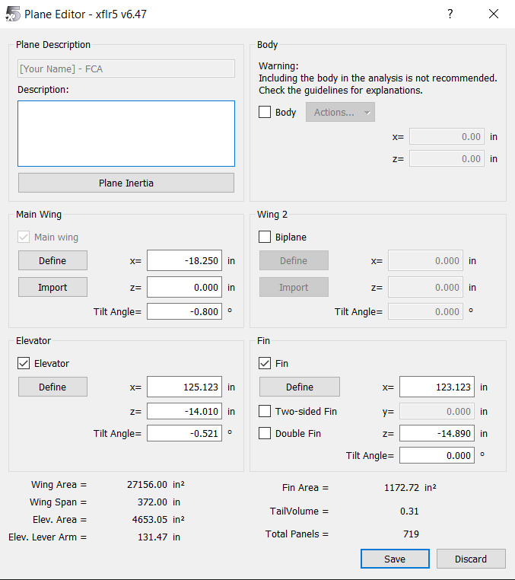
Edit your main editor so it looks like this
IGNORE the orange box for right now

Slide 16
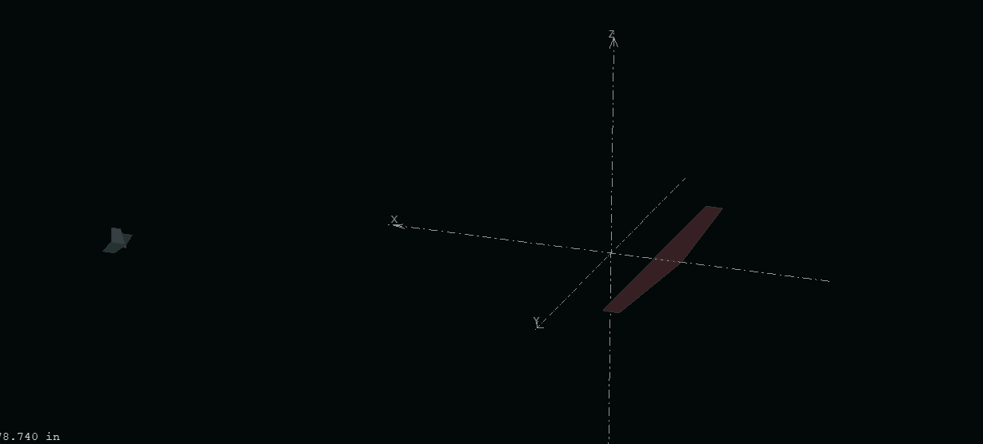
You should be here:

Slide 17
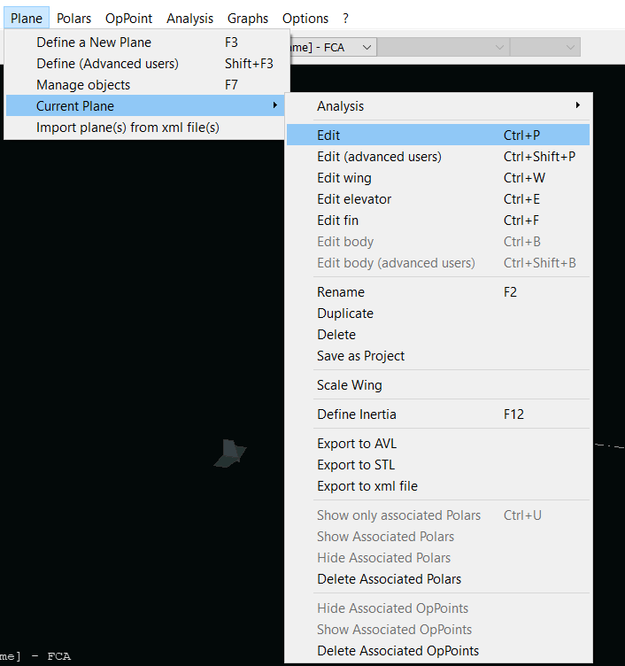
Note:
From now on you’ll get to the dash by going
plane>current plane> edit
Later you’ll just go directly to the part you wanna edit

Slide 18
Designing Your Tail
To edit any of your surfaces, you’re going to click “define” on the plane editor dash.

Slide 19
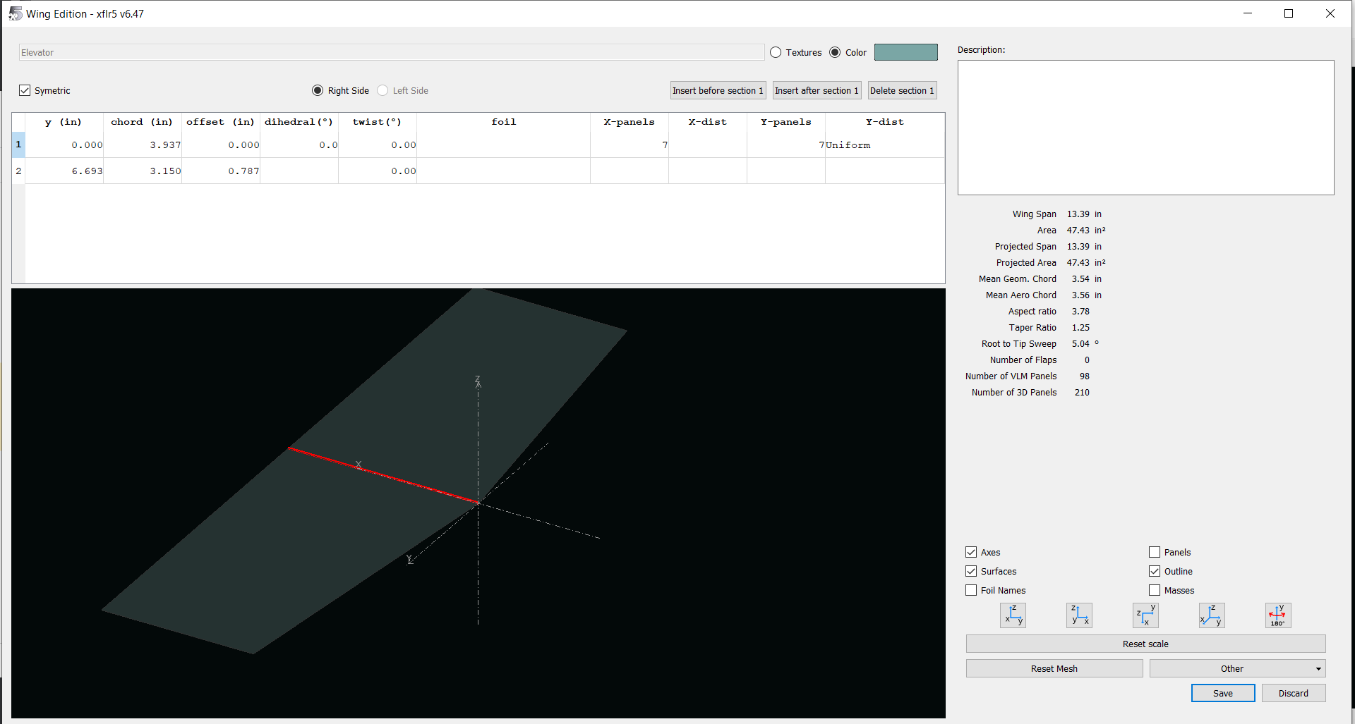
This is what it should look like

Slide 20
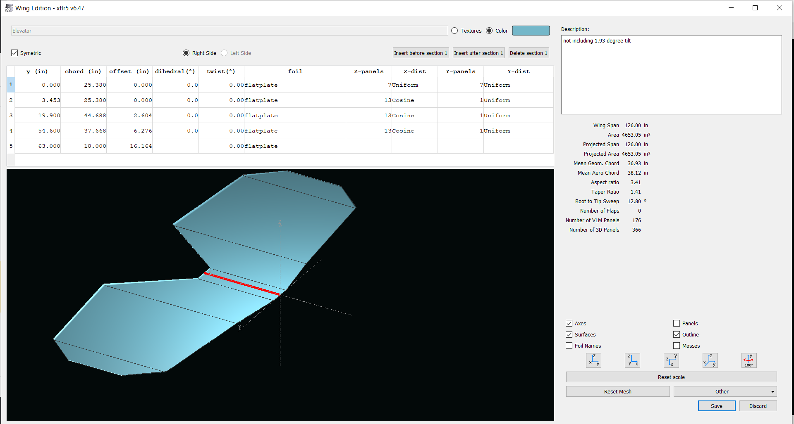
Okay now you’re gonna input the values so it looks like this:
Link to screenshot

Slide 21
Elevator, Just the numbers:

Slide 22
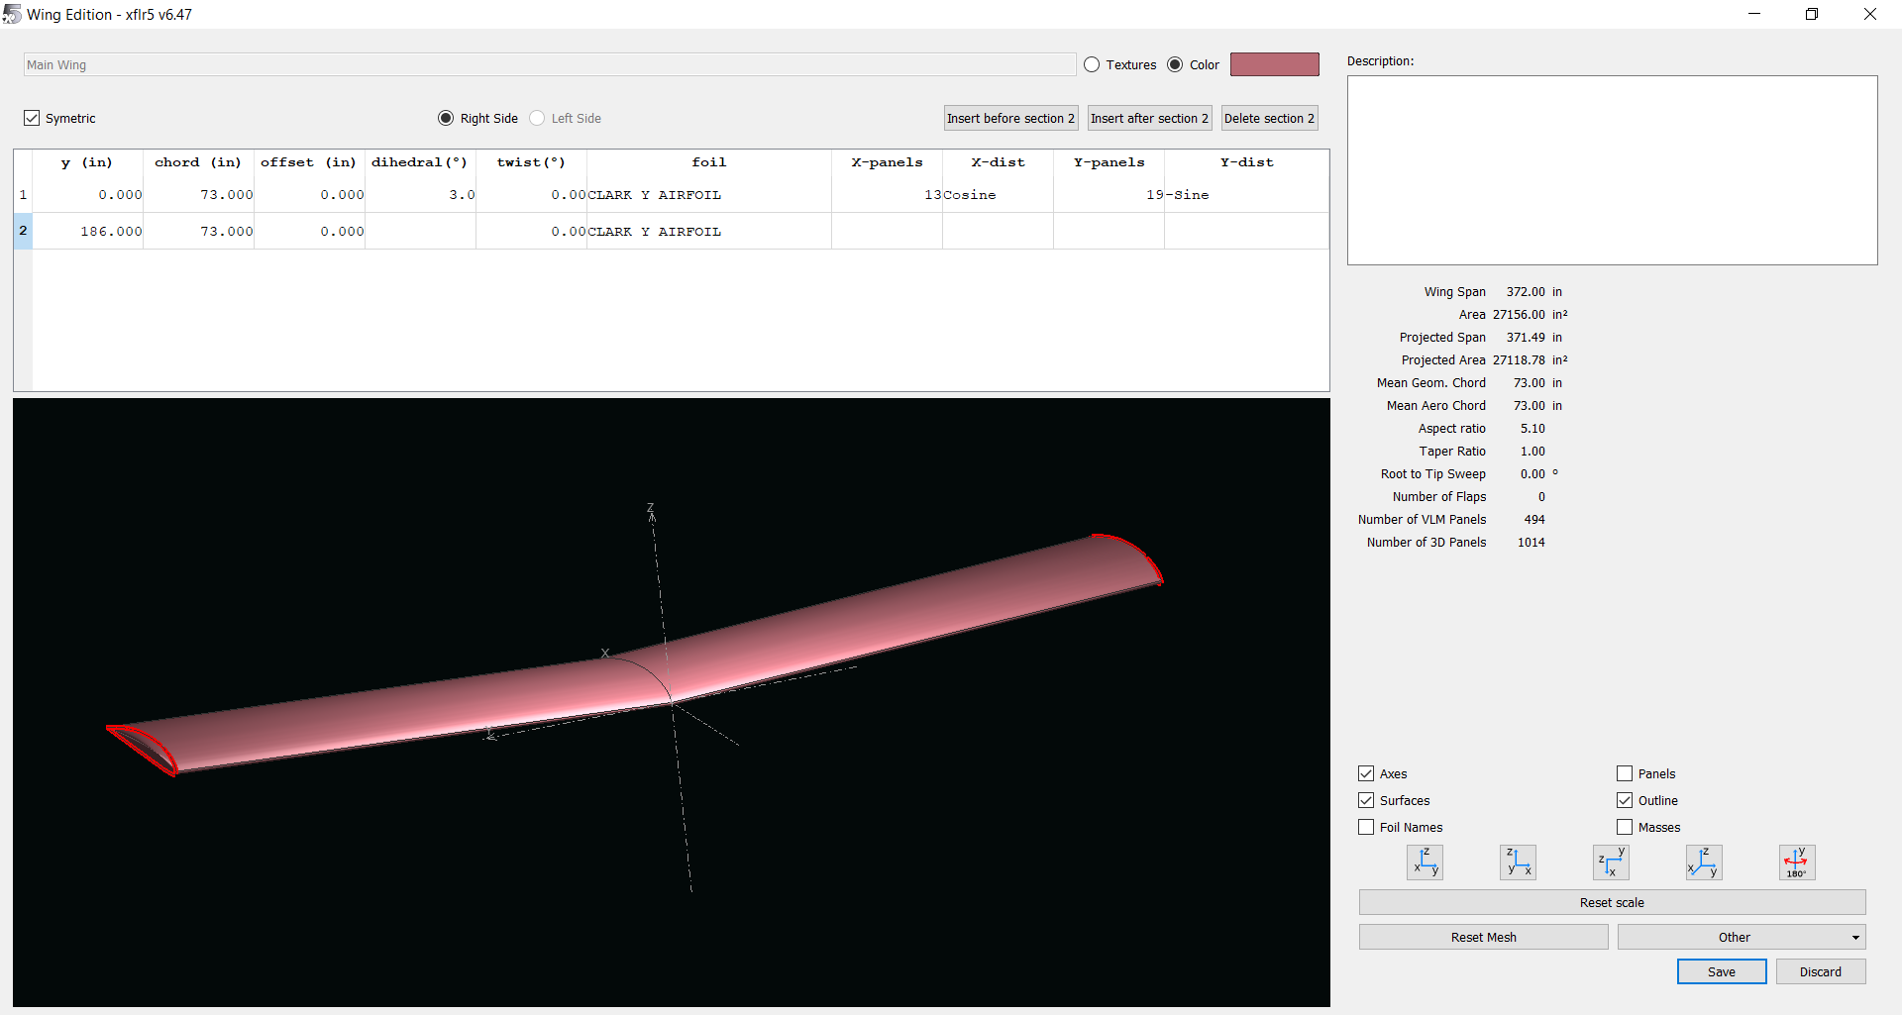
Wing:
Link to Screenshot

Slide 23
Wing, Just the Numbers:

Slide 24
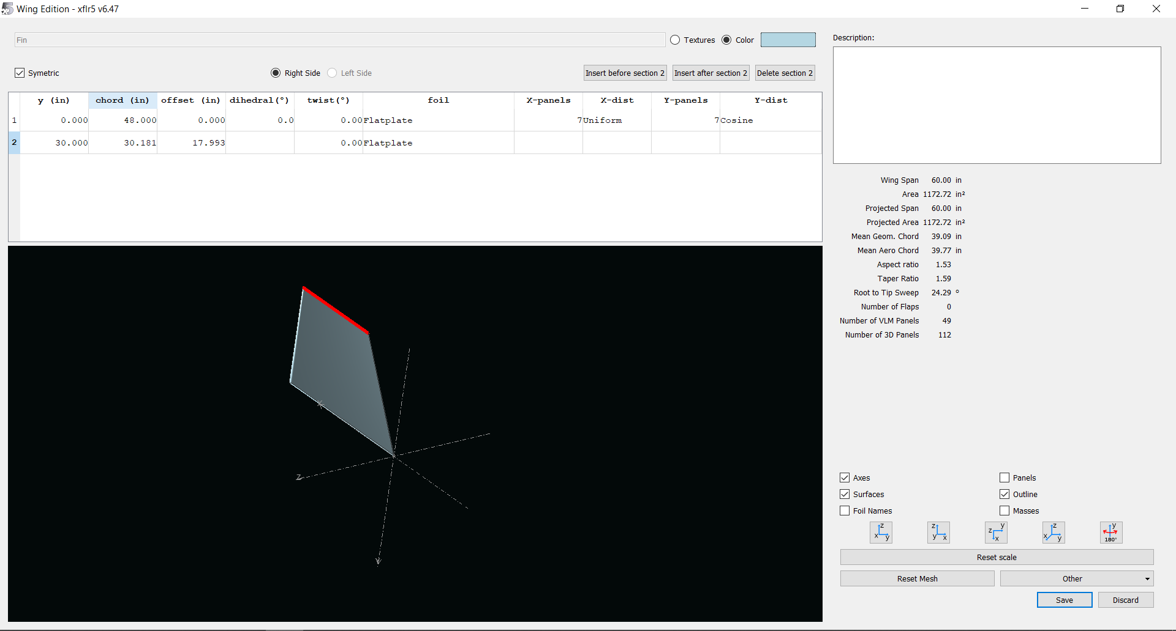
Rudder (their “Fin”)
Screenshot Link

Slide 25
Rudder, Just Numbers

Slide 26
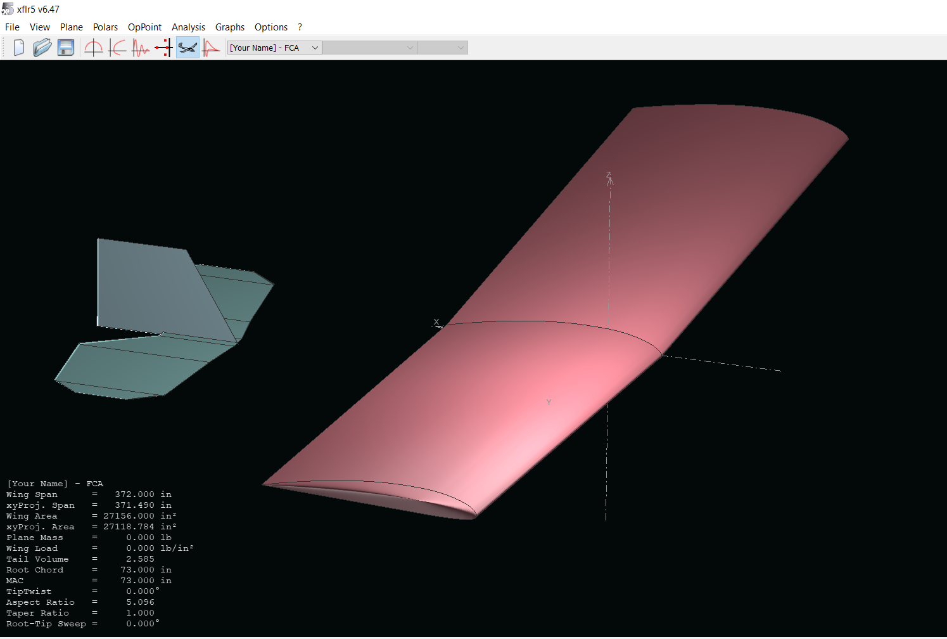
Sweet! You should be here:
Ok hit save

Slide 27
Masses
We’re going to add masses to the plane so the analysis can function accurately

Slide 28
This “Plane Inertia” tab is going to take you to where you’re gonna put ALL your masses

Slide 29
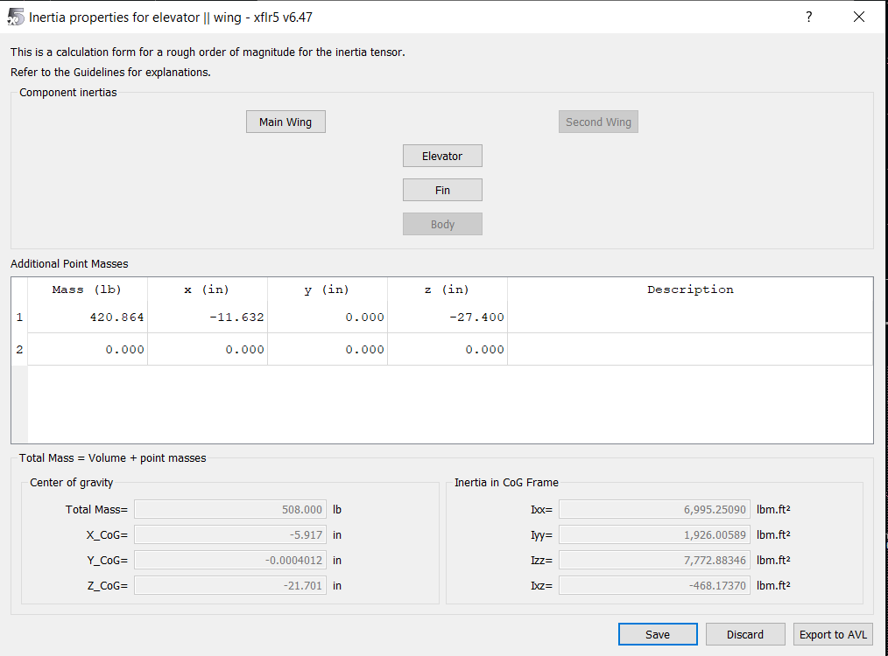
First is to add the point mass
This mass represents everything except for the wing, elevator, and fin
Aka: fuselage, batteries, human, etc

Slide 30
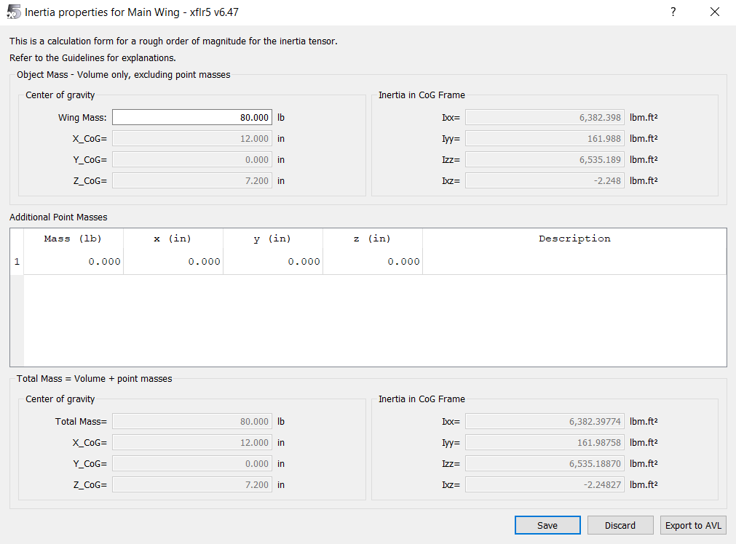
Wing

Slide 31

Elevator

Slide 32
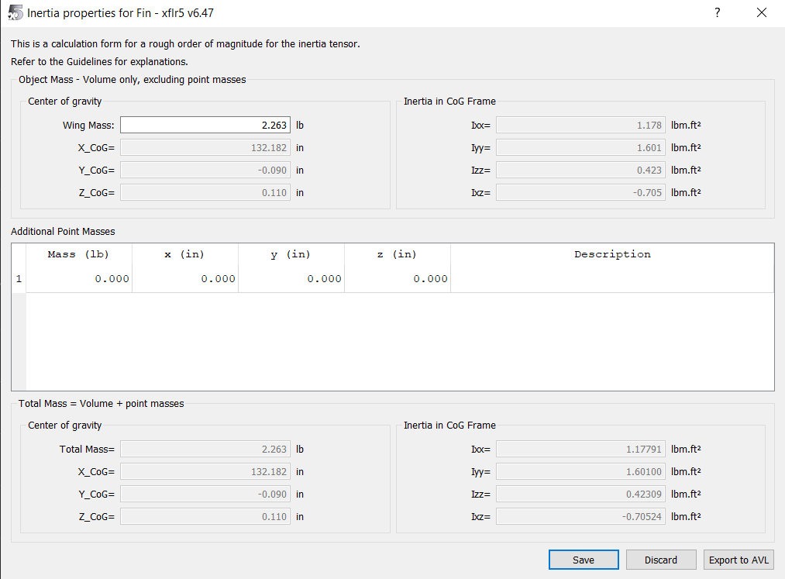
Fin (Rudder)

Slide 33
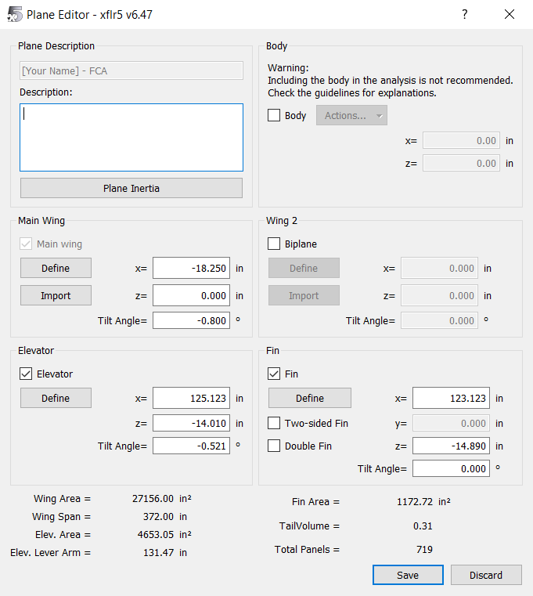
Now your main screen should exactly match this:

Slide 34
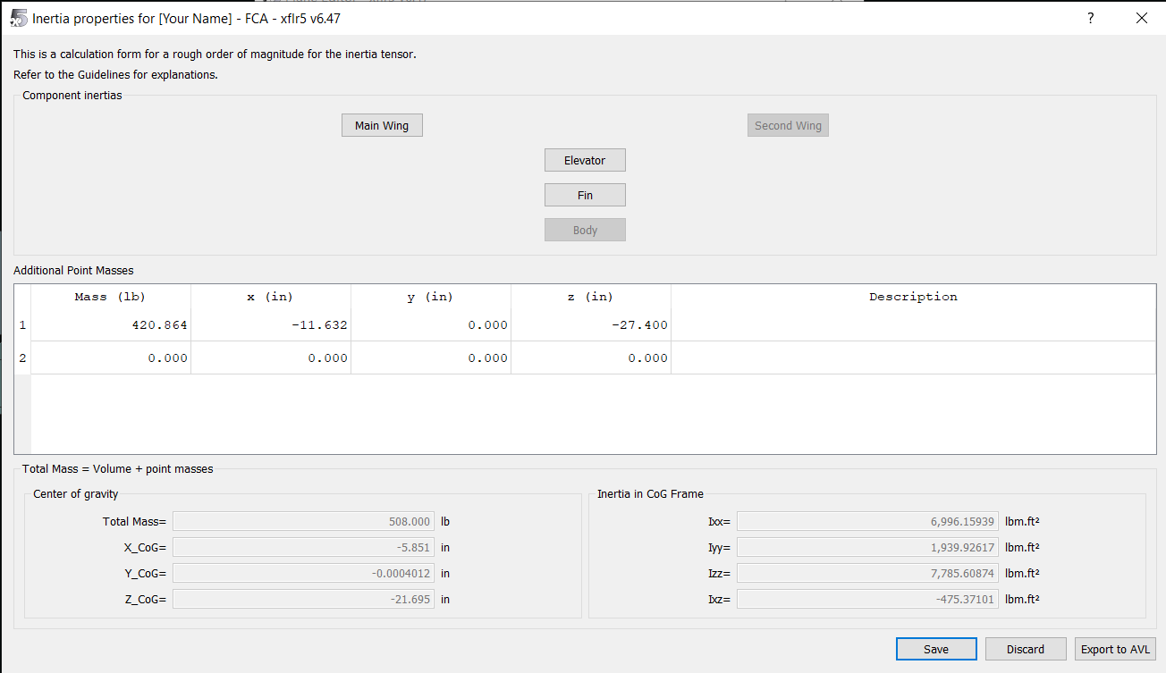
And your plane inertia home screen should also match:

Slide 35
Analysis
This tells the computer what your environment looks like

Slide 36
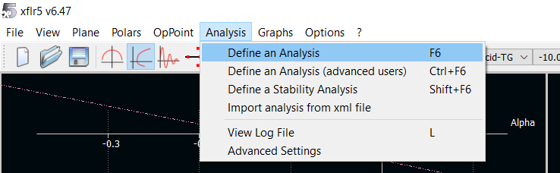
Define an Analysis

Slide 37
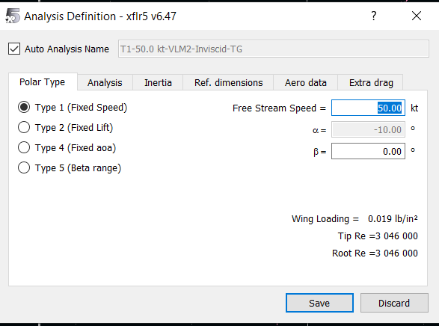
We care about the angle of attack - since the graph with the most information is the “coefficient of moment vs aoa” graph

Slide 38
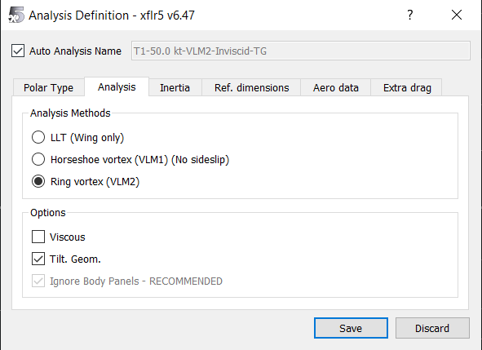
There will inevitably be sideslip, and we want it to take into account the tail section
I’m actually not sure why no “viscous” but it keeps giving us errors if we do check the box

Slide 39
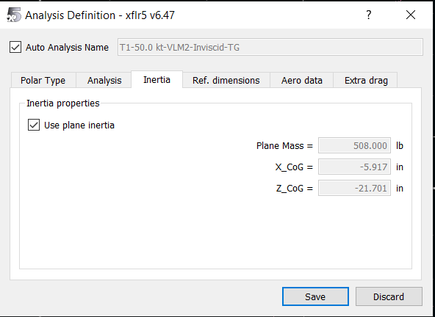

Slide 40
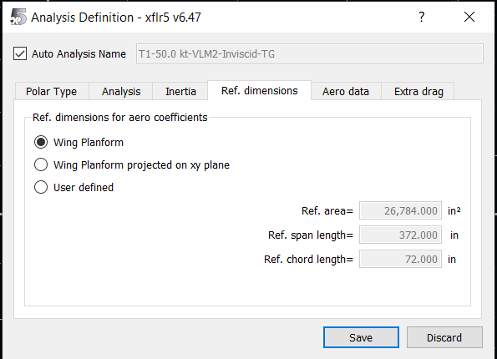
Basically saying the plane is 3D

Slide 41
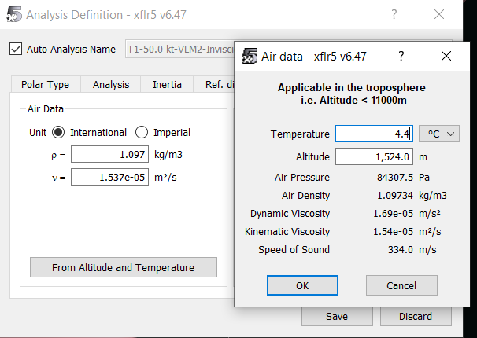

Slide 42
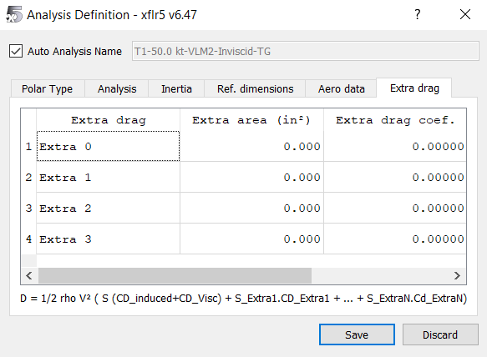

Slide 43
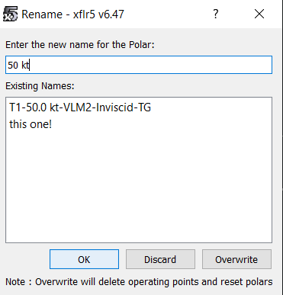
Hit “ok” then save!!!

Slide 44
Running an Analysis

Slide 45
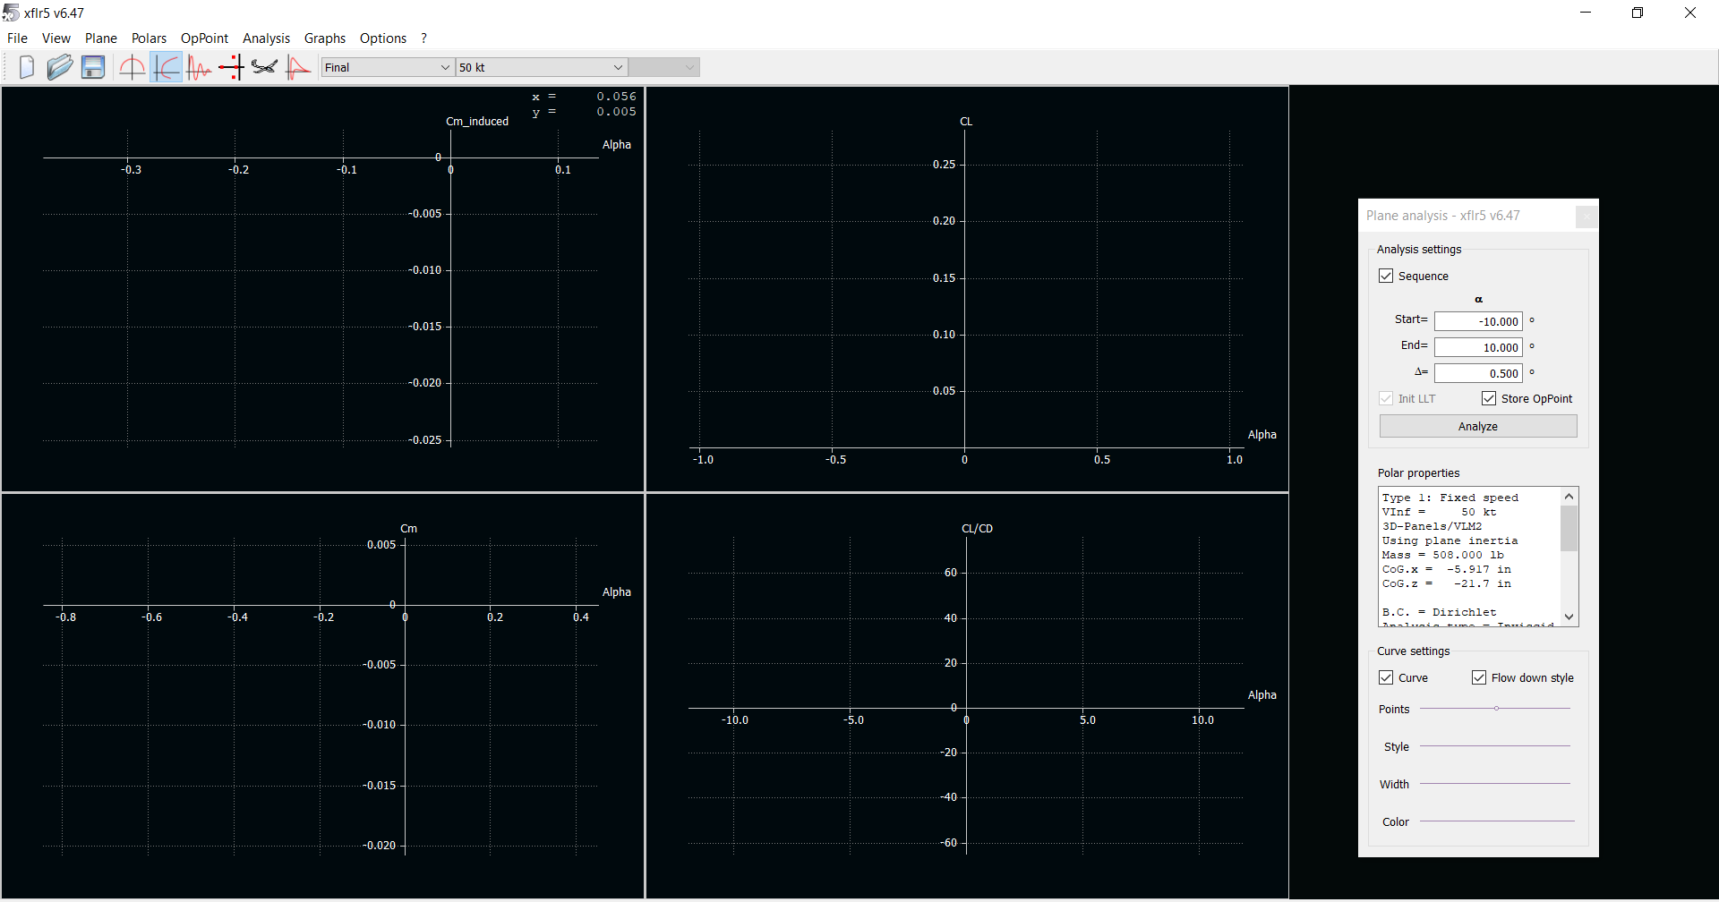

Slide 46
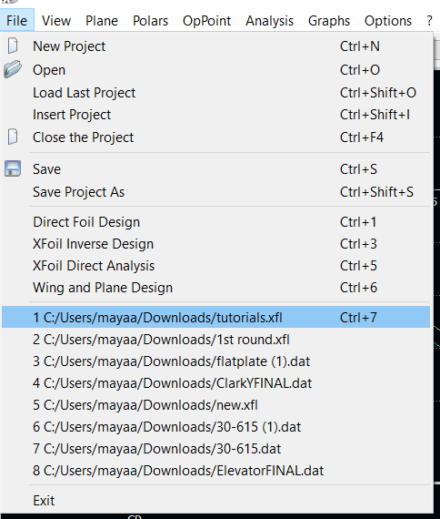
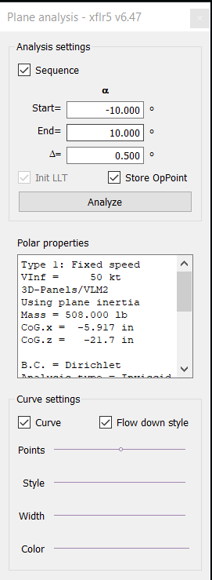
If you don’t have this bar:
First: hit save!!!
Go to “file” then click on the top one (which should be the one you’re working on)

Slide 47
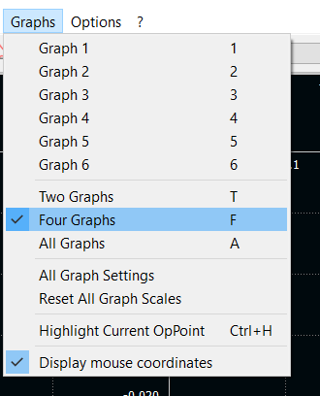
Graphs

Slide 48
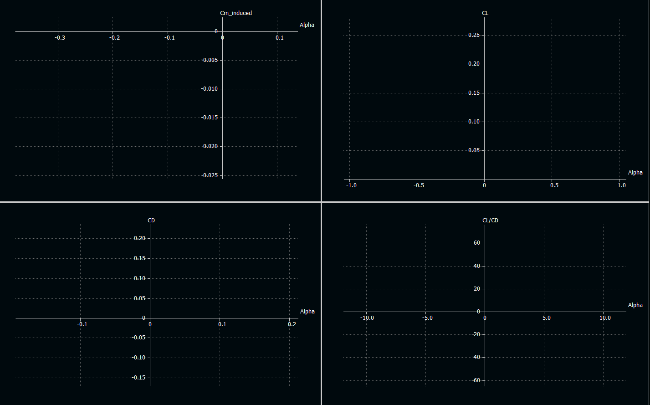
You’re gonna want these graphs
Alpha vs Cm_induced
Alpha vs CD
Alpha vs CL
Alpha vs CL/CD

Slide 49
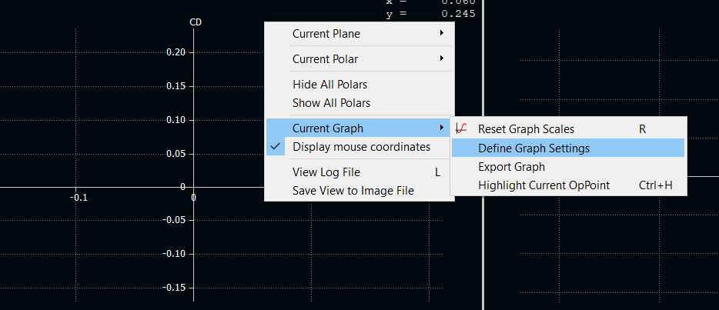
How to get them:
Right Click the graph you want changed

Slide 50
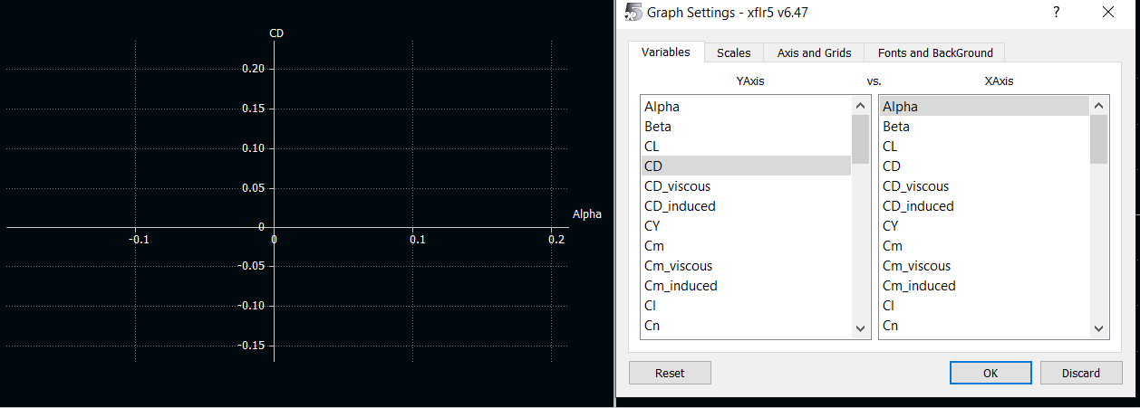
Then you’ll get a list

Slide 51
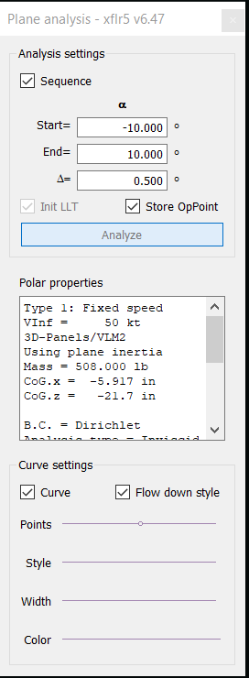
Coolio! Run a sim!

Slide 52
If you did everything correct:

Slide 53
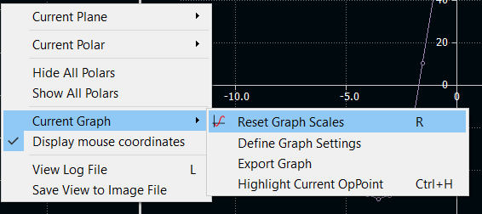
Fixing Scales
Right click:

Slide 54
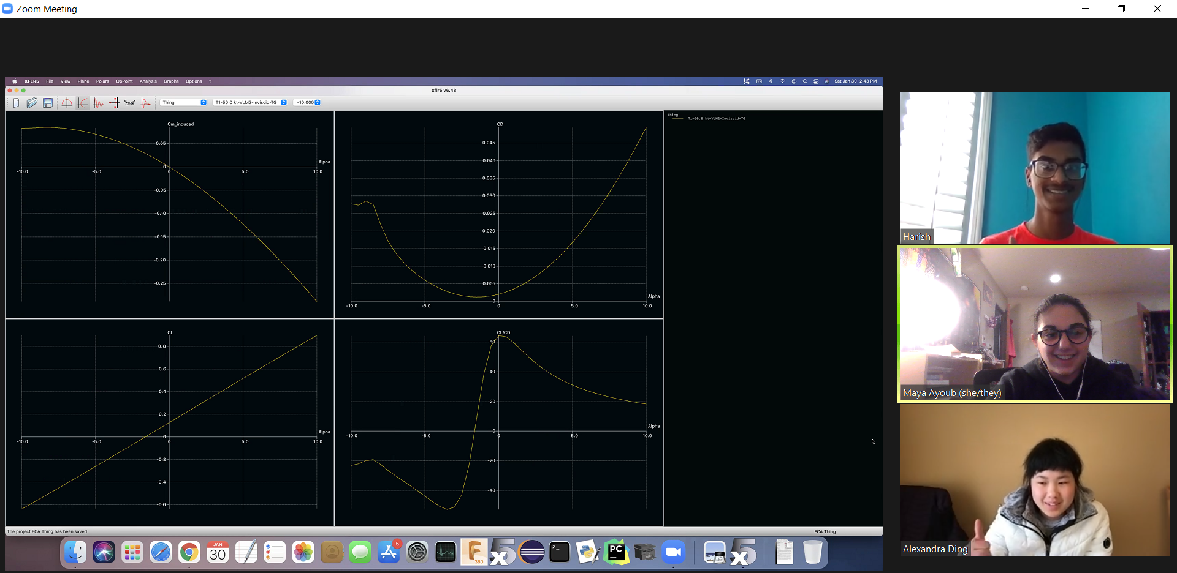
Thumbs up

Slide 55
Running a Stability Analysis

Slide 56
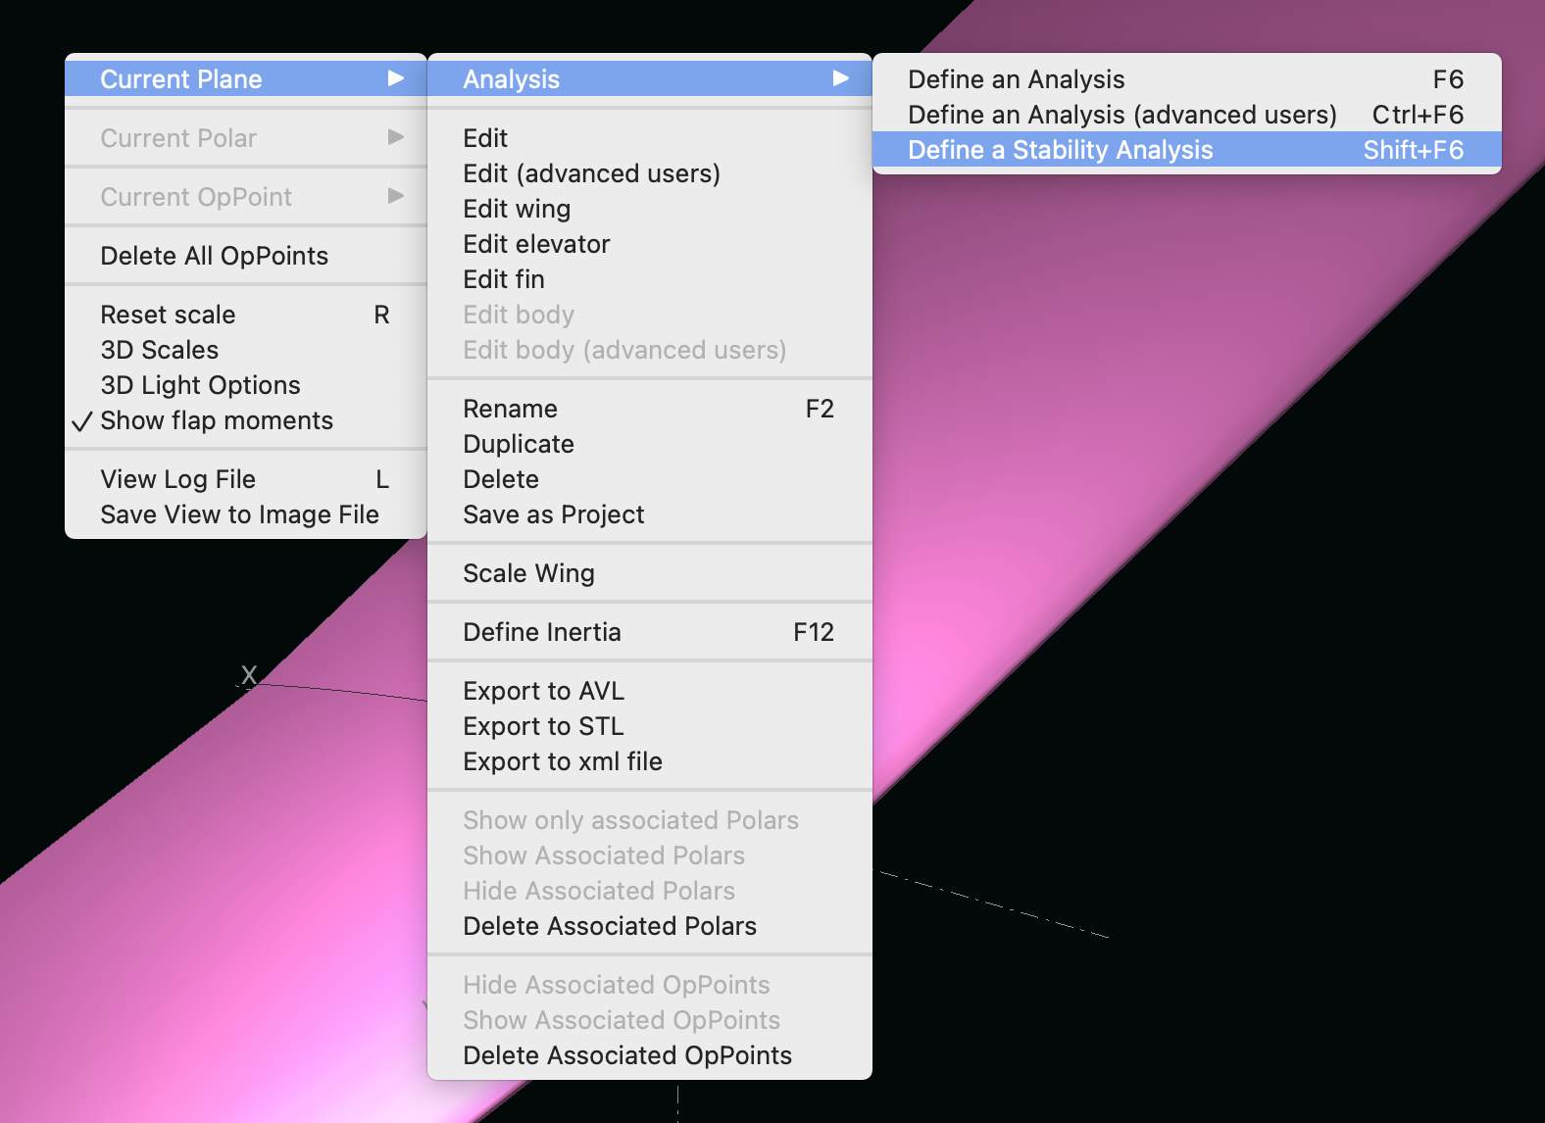
Right click > current plane > analysis > define a stability Analysis

Slide 57
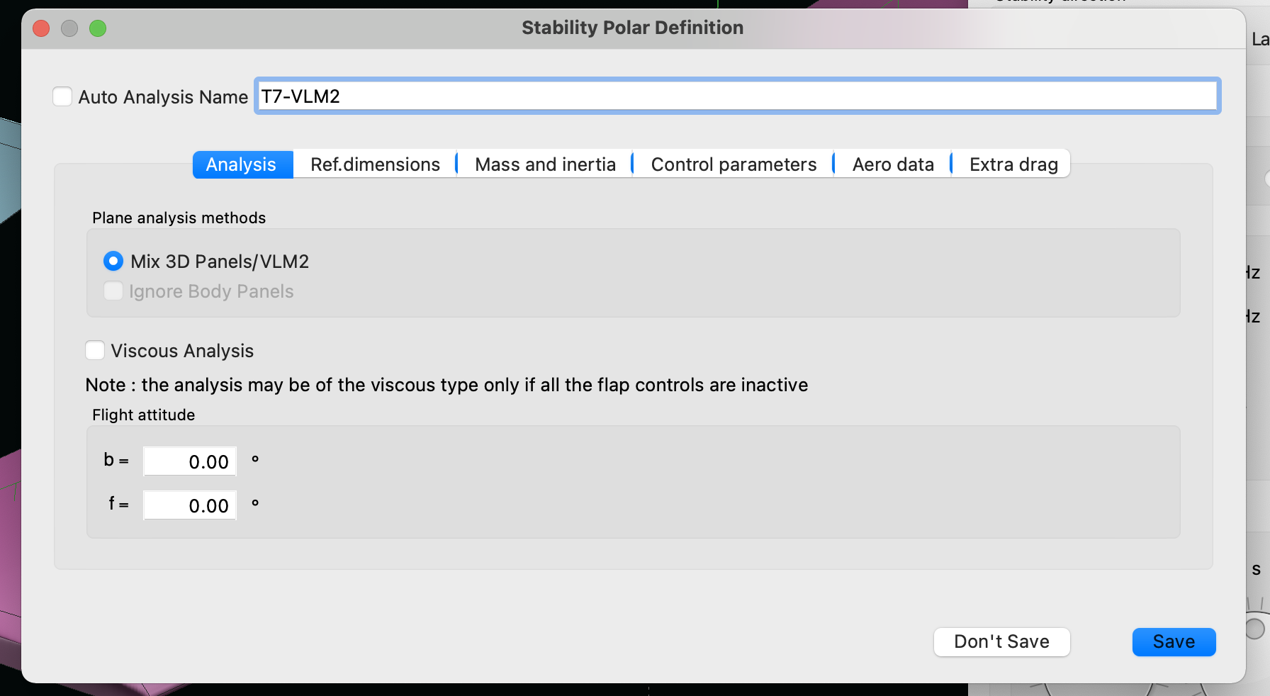
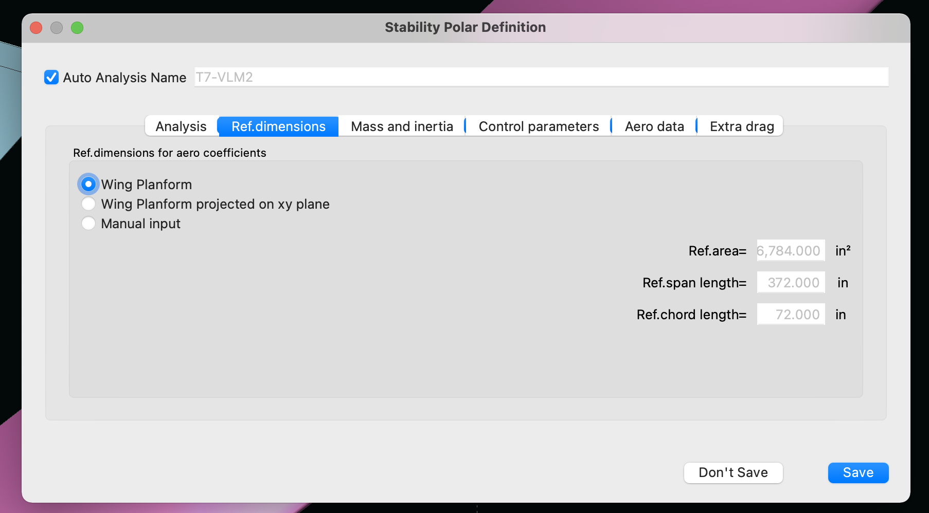
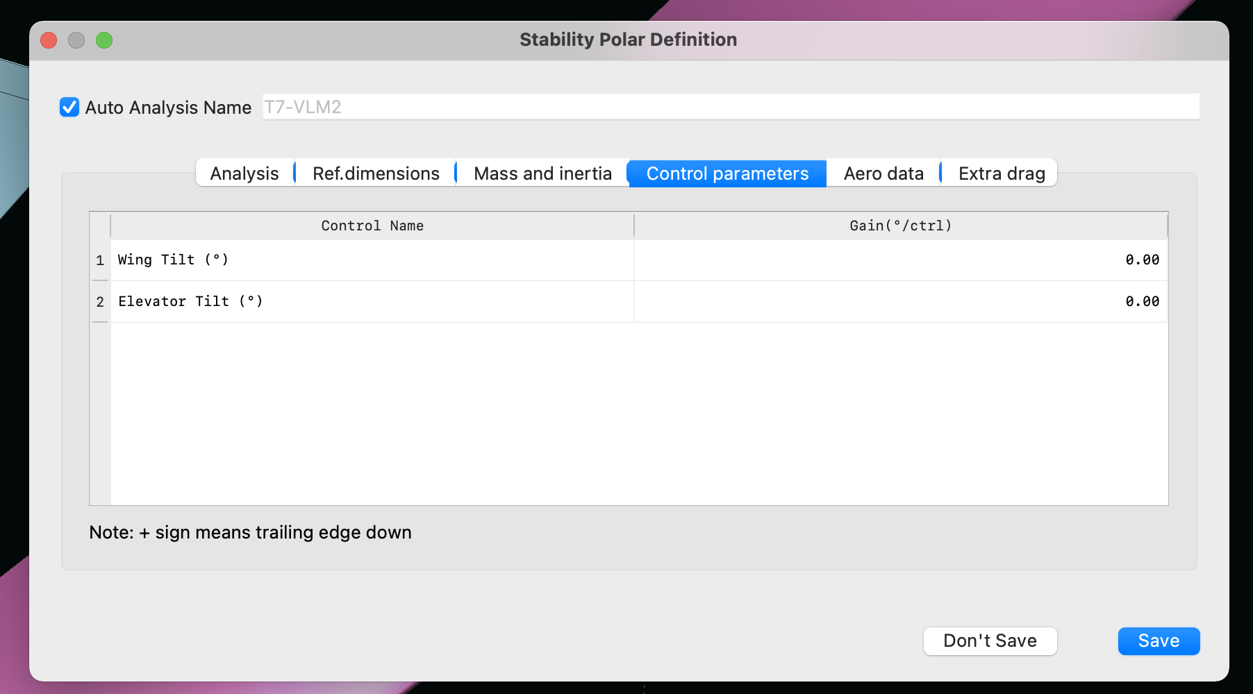
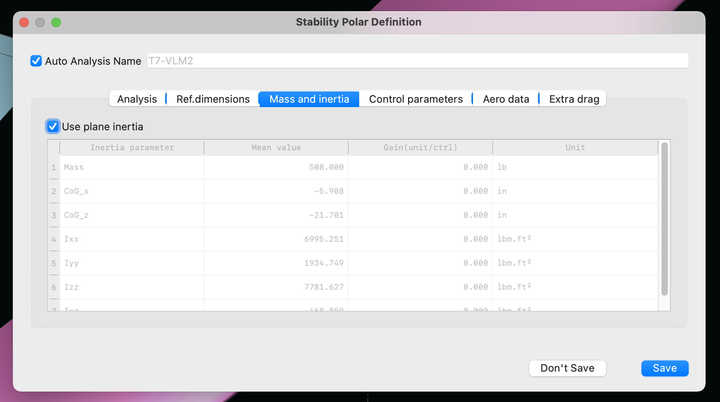
Make sure everything matches

Slide 58
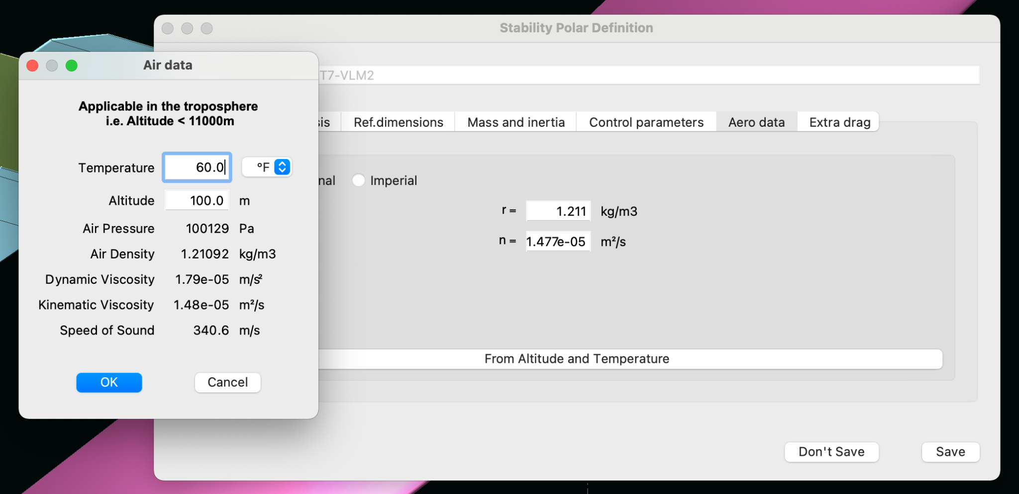
Hit “From Altitude and Temperature” then make sure everything matches

Slide 59

No extra drag! (unrealistic but whatever)
Hit save now that you’re done

Slide 60

You should see this!

Slide 61

Hit analyze

Slide 62

You can view what XFLR5 did in the log file

Slide 63

Semi-helpful visuals here

Slide 64

Click through the modes & hit animate
F = frequency without damping
F1 = frequency with damping
z = damping (between -1 and 1, with 1 being perfect damping)
t2 = time to double
t = time to reach 0
You may need to change time step/speed/amplitude

Slide 65
More information about the modes!
https://en.wikipedia.org/wiki/Aircraft_dynamic_modes

